Slide 1
Winter Term 21/22 Artificial Intelligence, Ethics & Engineering Lecture-7: Programming Machine Ethics
Prof. Dr. Holger Giese (holger.giese@hpi.uni-potsdam.de)
Christian Medeiros Adriano (christian.adriano@hpi.de) - “Chris”
Christian Zöllner (christian.zoellner@hpi.de)

Slide 2
The EU regulates AI but forgets to protect our mind [1]
High-risk AI systems in the AIA includes
face recognition;
AI used in critical infrastructures,
in educational, employment or emergency contexts;
in asylum and border contexts;
in social welfare or for credit scoring or
law enforcement or judicial purposes
The AIA [2] proposal aims at defining different areas of intervention [2] for AI systems according to their level of risk:
applications prohibited because they cause unbearable risks to fundamental rights and freedoms;
high-risk applications, i.e., applications that are not prohibited but subject to specific conditions to manage the risks;
limited risk and other negligible risk applications.
However,
“limited risk”: morally questionable AI applications, such as AI algorithms producing deepfakes (highly realistic fake videos or photos) as well as emotion recognition and biometric categorization systems.
[1] The EU regulates AI but forgets to protect our mind - https://europeanlawblog.eu/2021/07/07/the-eu-regulates-ai-but-forgets-to-protect-our-mind/
[2] AIA - https://osf.io/preprints/socarxiv/38p5f/

Slide 3
Quick recap
Argumentation

Slide 4
Normative Argumentation
[dePoel&Royakkers2011]
Argumentation Theory: An interdisciplinary study of analyzing and evaluating arguments.
Argumentation: A set of statements, of which one (the conclusion) is claimed to follow from the others (the premises).
Valid Argumentation: An argument whose conclusion follow with necessity from its premises: if the premises are true, the conclusion must be true.
E.g., Modus ponens: “q” follows from “if p then q” and “p”
Fallacy: An error or deficiency in an argument.
E.g., Modus tollens: “not p” follows from “if p then q” and “not q”
Notes:
[dePoel&Royakkers2011] Chapter 3, 4, 5
[Pereira&Saptawijaya2016] p. 110 trolly problem in different forms? Use to explain differences?
[Pereira&Saptawijaya2016] p. 20 double and triple effect & trolly problem
[Kizza2013] Chapter 3 Ethics abd Ethecial Analysis
[Reynolds2009] p. 19; overview

Slide 5
Types of arguments
Deductive (if premises are true, then the conclusion is true)
Inductive
Argument by analogy
Reduction ad absurdum
Abductive
Drawing a conclusion based on the explanation that best explains a state of events, rather from evidence provided by the premises. Also known as "inference to the best explanation".
“When you eliminate all the impossible, whatever remains, however improbable, must be the truth.” Sherlock Holmes

Slide 6
End of Recap

Slide 7
Argumentation as Verification
Argumentation is the basis for various forms of verifying designer and systems decisions
Design time
Run time
Manual verification
(inspection)
System logs verification
(auditing)
1
2
Offline
However -
we need to do more than verified behavior to establish justified trust in autonomous intelligent agents.
Human in the loop verification
(CAE tooling)
Automated verification
(monitoring)
3
4
Online
by Christian M. Adriano

Slide 8
How to go from Verification to Trust?
We need to be able to explain its decisions which leads to:
transparency,
accountability,
trust.
How?
Explainable AI [1] system that ground explanations on causal associations.
Logic Programming has been investigated for that [2]

Slide 9
Descriptive before Prescriptive Claims/Arguments
Descriptive: The autonomous system is equipped with a decision-making module that is trained on normal and exceptional situations.
Prescriptive: The autonomous system should not make decisions that endanger people’s lives. When faces with a dilemma, it should try to delegate the decision to a human.
We do not want to make prescriptive claims without proper descriptive ones.
Because we do not want to suggest (prescribe) solutions to a problem without having understood (described) the problem very well.

Slide 10

IEEE Ethics
IEEE Ethics in Action - in Autonomous and Intelligent Systems
https://ethicsinaction.ieee.org/
IEEE, 2020, Report: Addressing Ethical Dilemmas in AI: Listening to Engineers, https://standards.ieee.org/initiatives/artificial-intelligence-systems/ethical-dilemmas-ai-report.html
IEEE, Ethically Aligned Design
https://standards.ieee.org/content/dam/ieee-standards/standards/web/documents/other/ead1e.pdf
IEEE 7000™-2021 - IEEE Standard Model Process for Addressing Ethical Concerns During System Design https://standards.ieee.org/news/2021/ieee-7000.html

Slide 11
IEEE 7000™ Standard Model
IEEE 7000™ - Standard Model Process for Addressing Ethical Concerns During
The IEEE 7000™ standard provides [1] :
a system engineering standard approach integrating human and social values into traditional systems engineering and design.
processes for engineers to translate stakeholder values and ethical considerations into system requirements and design practices.
a systematic, transparent, and traceable approach to address ethically-oriented regulatory obligations in the design of autonomous intelligent systems.
The IEEE 7000 follows the Value-based Engineering (VbE) [2] methodology that supports: elicitation, conceptualization, prioritization of end user values during system design
Sources:
[1] IEEE Standard Model Process for Addressing Ethical Concerns During System Design https://standards.ieee.org/news/2021/ieee-7000.html
[2] WU, Value-based Engineering with IEEE 7000, https://www.wu.ac.at/value-based-engineering
Notes:
IEEE 7000™-2021 - IEEE Standard Model Process for Addressing Ethical Concerns During System Design https://standards.ieee.org/news/2021/ieee-7000.html

Slide 12
Need for Real-Time Validation and Monitoring [1]
“What we really need ... is real-time validation and monitoring rather than testing because testing itself requires a whole host of scenarios and cases that may not be representative or relevant to an adaptive system. What you really need is some form of smart contract style monitoring of a complex AI product in real-time, rather than at periodic phases, or in the old-fashioned style of going for some form of audit every three months or six months or one year. We are dealing with adaptive, non-deterministic systems. Testing is not going to be an adequate measure of assurance though this is obviously highly desirable if you didn’t have anything else. But in preference to periodic testing, we really do need some form of predictive oversight, and real-time monitoring.”
– Ali Hessami, Vice Chair & Process Architect, IEEE Ethics Certification Programme for Autonomous & Intelligent Systems
Automated Oversight [2]
Human-in-the-loop Integration
sources:
[1] IEEE, 2020, Report: Addressing Ethical Dilemmas in AI: Listening to Engineers https://standards.ieee.org/content/dam/ieee-standards/standards/web/documents/other/ethical-dilemmas-in-ai-report.pdf
[2] Munoko et al, “The Ethical Implications of Using Artificial Intelligence in Auditing”
Notes:
“Testing is typically done prior to deployment but given the fact that AI systems by design learn and change over time given a particular context of implementation, testing processes need to be rethought. At the very least testing ought to be done iteratively and systematically throughout the system lifetime. Whether via iterative testing or real-time monitoring, solutions must be able to deal with changing social and technological contexts as well as account for system adaptability.”
source: IEEE, 2020, Report: Addressing Ethical Dilemmas in AI: Listening to Engineers https://standards.ieee.org/content/dam/ieee-standards/standards/web/documents/other/ethical-dilemmas-in-ai-report.pdf

Slide 13
Logic Programming for Machine Ethics

Slide 14
Reference Architecture - Prospective Logic Agent [1]
Input
AGENT
Active Goals
+
Integrity Constraints
Knowledge Base
Update committed abducibles
Moral Theory
Abductive Hypothesis
a posteriori Preferences
+
Utility Theory
Abductive Scenarios
a priori Preferences
+
Utility Theory
External Oracles
[1] Pereira & Saptawijaya, Programming Machine Ethics, 2016
Notes:
[1] Pereira & Saptawijaya, Programming Machine Ethics, 2016

Slide 15
Logic Programming in Context [Russell & Norvig 2015]
Problem Solving
Solving as Searching (Uniformed and Informed-Heuristic Techniques)
Beyond Classical Search (Continuous Spaces, Non-Deterministic Actions, Partial Observations)
Adversarial Search (Games, Alpha-Beta Pruning)
Constraint Satisfaction Problems (Constraint Propagation, Backtracking, Local Search)
Learning
Learning from examples (Supervised learning, one section with NN)
Knowledge in Learning (Explanation-based Learning, Inductive Logic Programming)
Learning Probabilistic Models (Statistical learning, EM algorithm)
Reinforcement learning (model-free, model-based, online, batch)
Knowledge-Reasoning and Planning
Logical Agents
First-Order Logic
Inference in First-Order Logic
Classical Planning
Planning and Acting
Knowledge Representation
Communicating, Perceiving, and Acting
Natural Language Processing (Information Retrieval, Text Classification)
Natural Language Communication (Parsing, Machine Translation, Speech Recognition)
Perception (Object Recognition)
Robotics (Planning under uncertainty)
Uncertain Knowledge and Reasoning
Quantifying Uncertainty (Probability, Bayes Rule)
Probabilistic Reasoning (Bayesian Networks, Markov Networks)
Probabilistic Reasoning over Time (Hidden Markov Models, Kalman Filters)
Making Simple Decisions (Utility Theory, Decision Networks)
Making Complex Decisions (Value & Policy Iteation, Markov Decision Process, Game Theory, Mechanism Design)
The Ethics and Risks of Developing Artificial Intelligence (pages 1049-1055)
Source: Russell & Norvig, 2015, Artificial Intelligence – A Modern Approach
Notes:
[Russell & Norvig 2015] Artificial Intelligence – A Modern Approach

Slide 16
Logic Programming - brief history – part-1
First-Order Logic [Robinson 1965]
The resolution principle, the notion of unification, and a unification algorithm
Allowed to prove theorems formulated in first-order logic, i.e., obtain "ye" or "no" answer to a question.
However, it was missing the capability of "computing" answers.
Logic Programming [Kowalski 1974]
Modified the resolution that deals with a sub-set of first-order logic.
This allowed to generate a substitution that satisfies the original formula.
This substitution can be interpreted as a result of a computation.
Many competing proposals emerged at the time, but logic programming showed to be the simplest and most versatile one.
Notes:
Kowalski, R., 1974, Predicate Logic as Programming Language, in proc. IFIP'74, pp. 569-574.
Jaffar, J., et al., 1992, The CLP(R) language and System, ACM Transactions in Programming Languages and Systems, 14, p. 339-395.
Colmerauer, A., 1990, An introduction to Prolog III, Communications of the ACM, 33, pp. 69-90.
Van Hentenryck, P., 1989, Constraint Satisfaction In Logic Programming, The MIT Press

Slide 17
Logic Programming - brief history – part-2
In parallel, Colmerauer and colleagues developed a language for natural language processing based on automated theorem proving, which lead in 1973 to the creation of Prolog (which due to multiple contributions became a general-purpose programming language).
The logic programming paradigm supported the development of the constraint logic programming (CLP) paradigm, for instance Prolog III [Colmerauer 1990], CLP(R) [Jaffar et al. 1992], and CHIP [Van Hentenrcyck 1989]
CLP allows to express and solve constraint satisfaction problems (CSP),
which involved finding the optimal set of constraints (values to variables) in large spaces, e.g., physics and combinatorial optimization.
CPS problems are tackled by constraint propagation (top-down search), backtracking, and branch & bound search.
Notes:
Kowalski, R., 1974, Predicate Logic as Programming Language, in proc. IFIP'74, pp. 569-574.
Jaffar, J., et al., 1992, The CLP(R) language and System, ACM Transactions in Programming Languages and Systems, 14, p. 339-395.
Colmerauer, A., 1990, An introduction to Prolog III, Communications of the ACM, 33, pp. 69-90.
Van Hentenryck, P., 1989, Constraint Satisfaction In Logic Programming, The MIT Press

Slide 18
Answer Set Programming (ASP)
ASP = DB + LP + KR + SAT
Database + Logic Programming + Knowledge Representation + Boolean Satisfiability
Notes:
http://potassco.org
Easy answer set programming, introduction, running first example
https://www.youtube.com/watch?v=PXk3xYbmy_s

Slide 19
Workflow [1]
Problem
Solution
Solving
Logic Program
Grounder
Solver
Stable Models
Stable Models
Elaborating
Source: Torsten Schaub (University of Potsdam), Answer Set Programming in a Nutshell, https://youtu.be/m_YuE2E_bck?t=3513
Notes:
Source: Torsten Schaub (University of Potsdam), Answer Set Programming in a Nutshell, https://youtu.be/m_YuE2E_bck?t=3513

Slide 20

Next topics - Representing Morality in Logic Programming
Moral Permissibility
Doctrines of Double Effect and Triple Effect
Scanlonian Contractualism
Dual-Process
Abduction
Preferences Over Abduction Scenarios
Tabling Abduction and Updating
Counterfactuals
Counterfactual Thinking and Moral Reasoning
Counterfactual in Logic Programming
Causation and Intervention in Logic Programming

Slide 21
Planning the Ethics Experiment
Research Questions - Think of ways to inform our reasoning about a particular ethical dilemma, for instance, by obtaining answers to the following questions:
What are other popular reasoning of the particular dilemma?
How intuitive (easy to understand) people find certain reasonings?
How variations in phrasing affect people judgments?
When do people distinguish between the notion of knowing something versus just believing in something?
Experiment design
What would be the audience? Which demographics? How many people?
What would be the task? Are there different ways of designing it that would impact the answers?
How would you execute? Distribution of tasks.
How would you analyze the results?

Slide 22
END
The whole thinking process is still rather mysterious to us, but I believe that the attempt to make a thinking machine will help us greatly in finding out how we think ourselves.
—Alan Turing, 1951

Slide 23
Looking ahead - Future Task
Execute one example in the tutorial
Suggest two sets of arguments to be coded in ASP
Discuss your reasoning, justification, and difficulties within your group
Prepare a short demo to present in the lecture time

Slide 24
Counterfactual Explanations Can Be Manipulated
https://openreview.net/pdf?id=iaO_IH7CnGJ

Slide 25
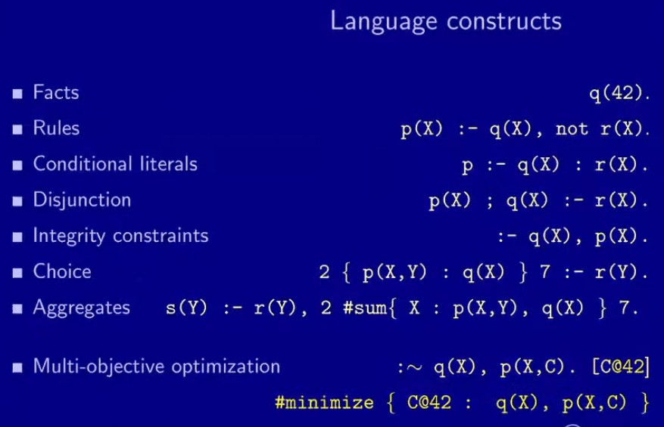
Notes:
https://youtu.be/m_YuE2E_bck?t=3513
ASP
SAT = propositional logic
ASP problems have three parts: guesser, checker, optimizer
https://youtu.be/m_YuE2E_bck?t=3751

Slide 26
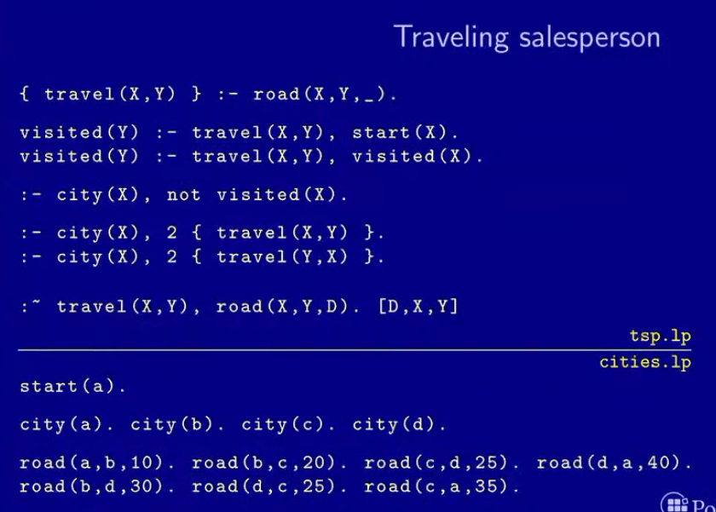
Notes:
Encoding file tsp.lp
Instance file = cities.lp

Slide 27
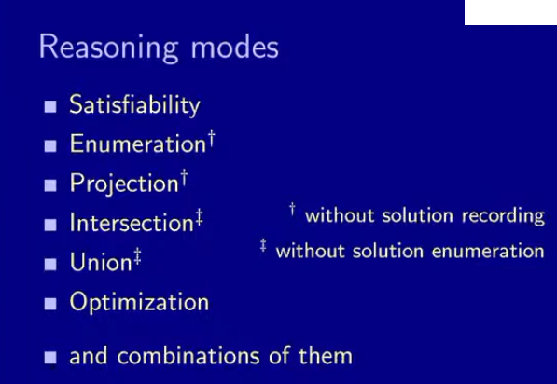

Slide 28
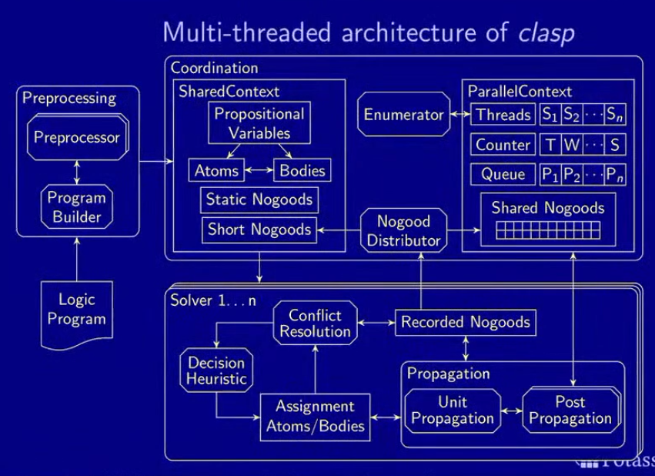

Slide 29
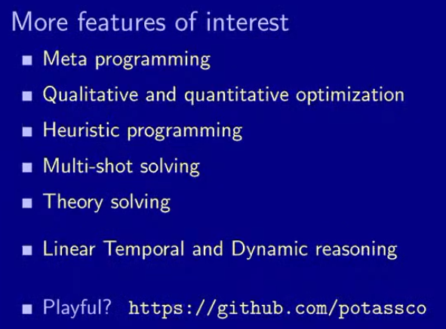
Features
Meta Programming
Qualitative

